Slide 1



Citizen science data complements state agency data to fill gaps in species inventories of state parks
Samantha K. Lowe, Brittany M. Mason,
Nia A. Morales, and Corey T. Callaghan
Notes:
15mins with 3-5 mins of questions MAX

Slide 2
Introduction
Species monitoring is a critical component of biodiversity research and conservation
Comprehensive data collection is labor-intensive, time-consuming, and expensive
Florida state law (Statute 253.034) mandates that all government-owned lands be monitored and managed by government agencies

Slide 3


Previous work: Utility of citizen science in species and resource monitoring
Limited utility? :
Similar biases in CS and professional data
Ex. Lepidoptera
Only comparable in quality to professional data sometimes
Bee biodiversity measured better by professional data (PA, USA)
(Díaz-Calafat et al. 2024; Guerrini et al. 2018; Aceves-Bueno et al. 2017; Turley et al. 2024)
Complimentary? :
Frog biodiversity
Invasive plant distribution
Reef fish biodiversity
Avian species richness
Invasive mosquito
Water quality assessments
(Callaghan et al. 2020; Dimson et al. 2023; Roberts et al. 2022; Callaghan et al. 2018; Pernat et al. 2021; Hadj-Hammou et al. 2017)
OR

Slide 4
Can citizen science data be used in conjunction with state agency data to create more complete species inventories in state parks?
Research Question:

Slide 5
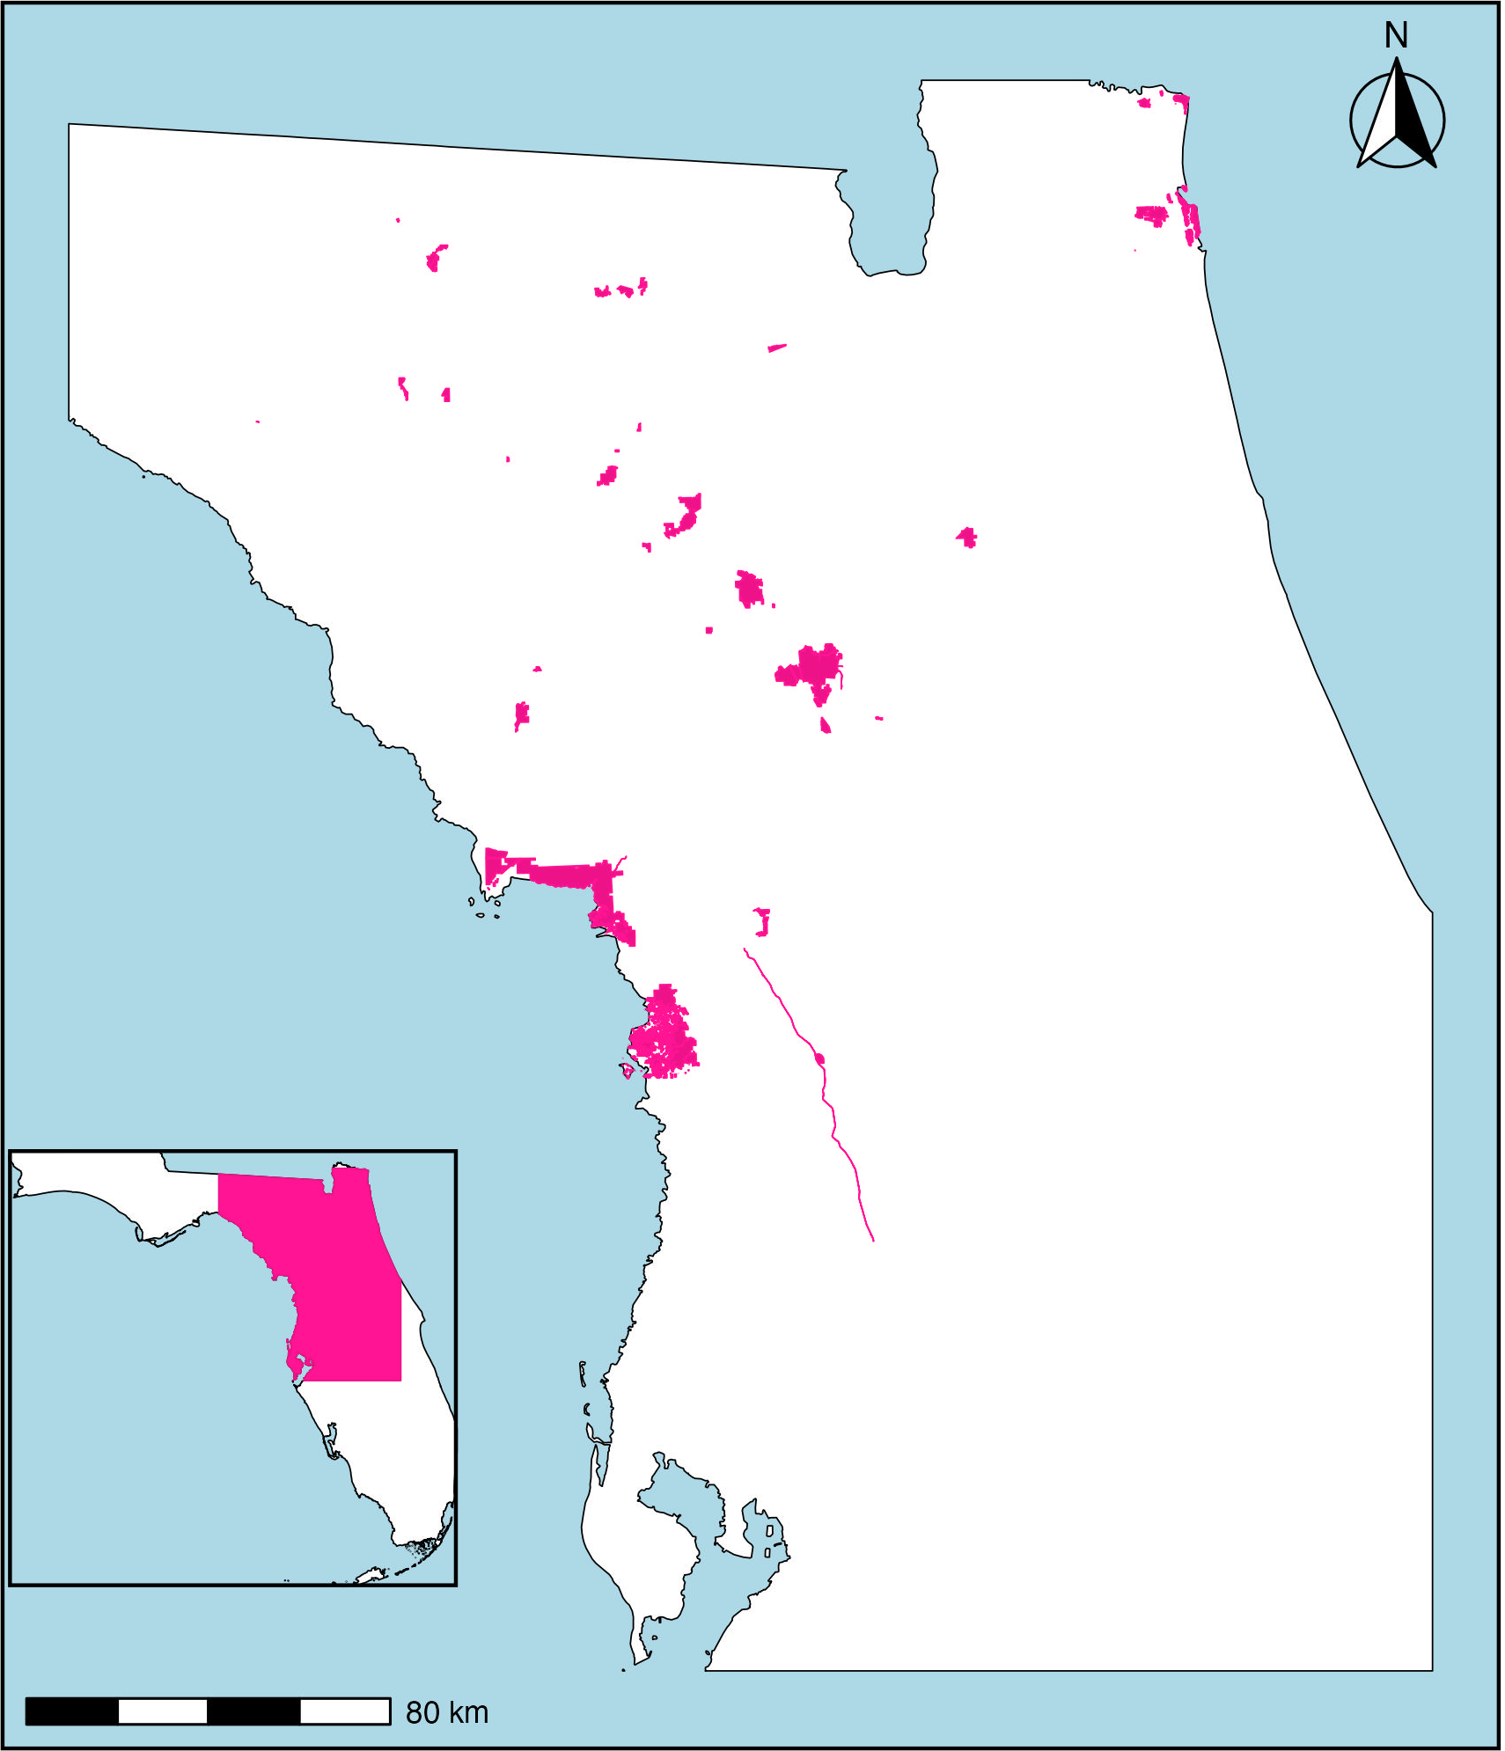




Methods
39 state parks in Florida
Species lists from the Florida Department of Environmental Protection (FDEP) used in management plans
Species lists from citizen science (combination of eBird and iNaturalist observations)
Notes:
Taxonomic harmonization

Slide 6
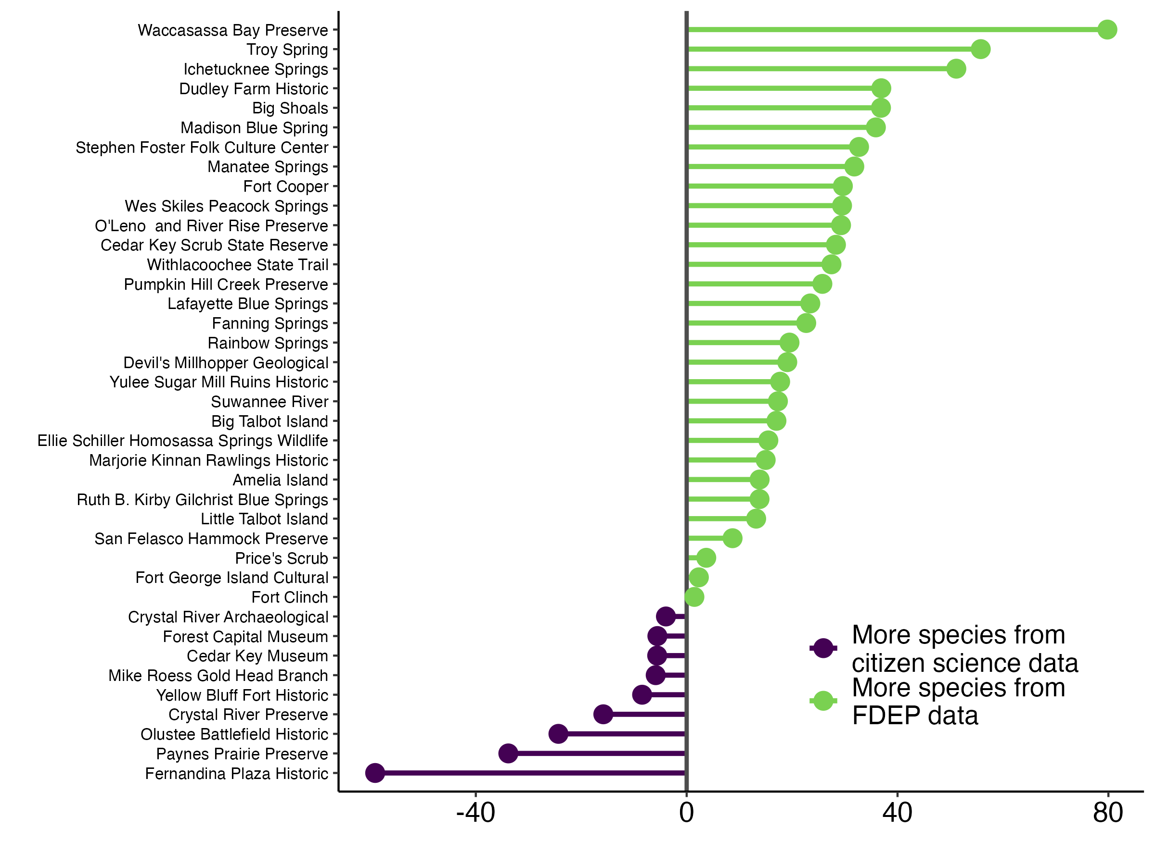


5,454 total species
3,948 species documented by FDEP
3,540 species documented by citizen science
&
(Species count from FDEP – Species count from CS)
* 100%
(Species count from FDEP + Species count from CS)

Slide 7
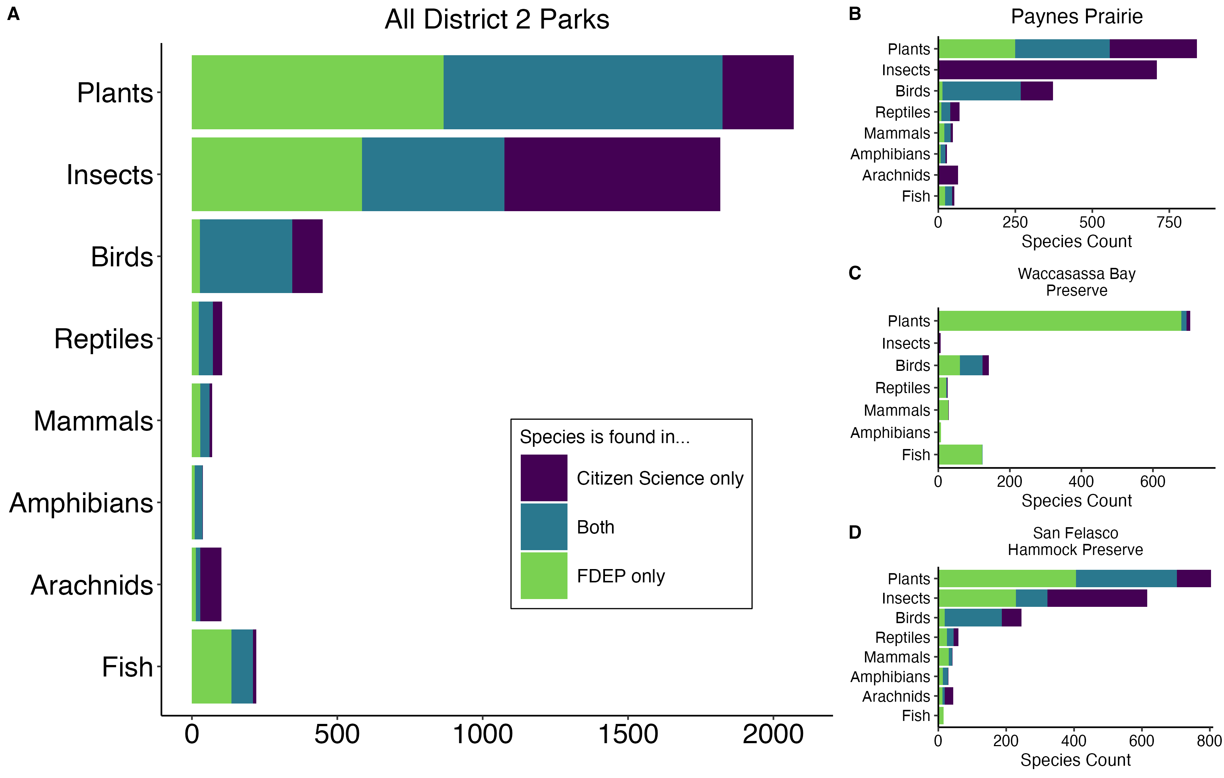


11.8%
40.8%
23.3%
Species Count
Notes:
CS makes major contributions to (1) insects 40.8% CS only (2) birds 23.3% and (3) plants 11.8%.
High degree of variation across parks.

Slide 8
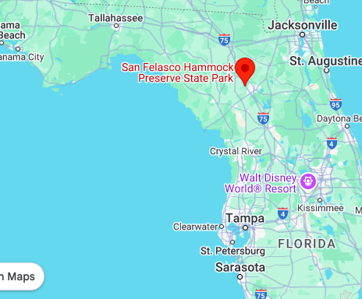
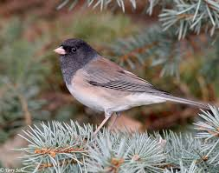
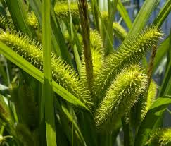
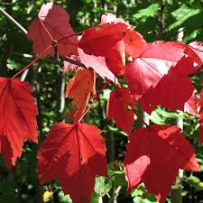
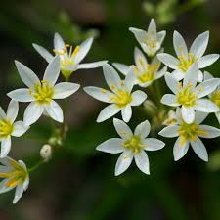
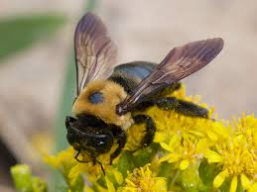
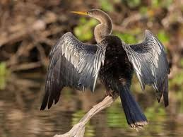
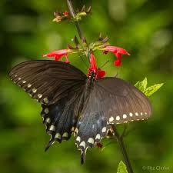
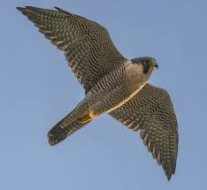
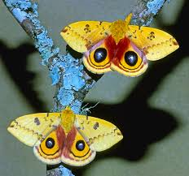
Case Study: San Felasco Hammock Preserve
FDEP only
Dark-eyed Junco
Junco hyemalis
FDEP only
Bristly Sedge
Carex comosa
Both
Red Maple
Acer rubrum
CS only
Crowpoison
Nothoscordum bivalve
Both
Anhinga
Anhinga anhinga
FDEP only
Eastern Carpenter Bee
Xylocopa virginica
Both
Spicebush Swallowtail
Papilio troilus
CS only
Peregrine Falcon
Falco peregrinus
2,069 species
CS only
Io Moth
Automeris io

Slide 9
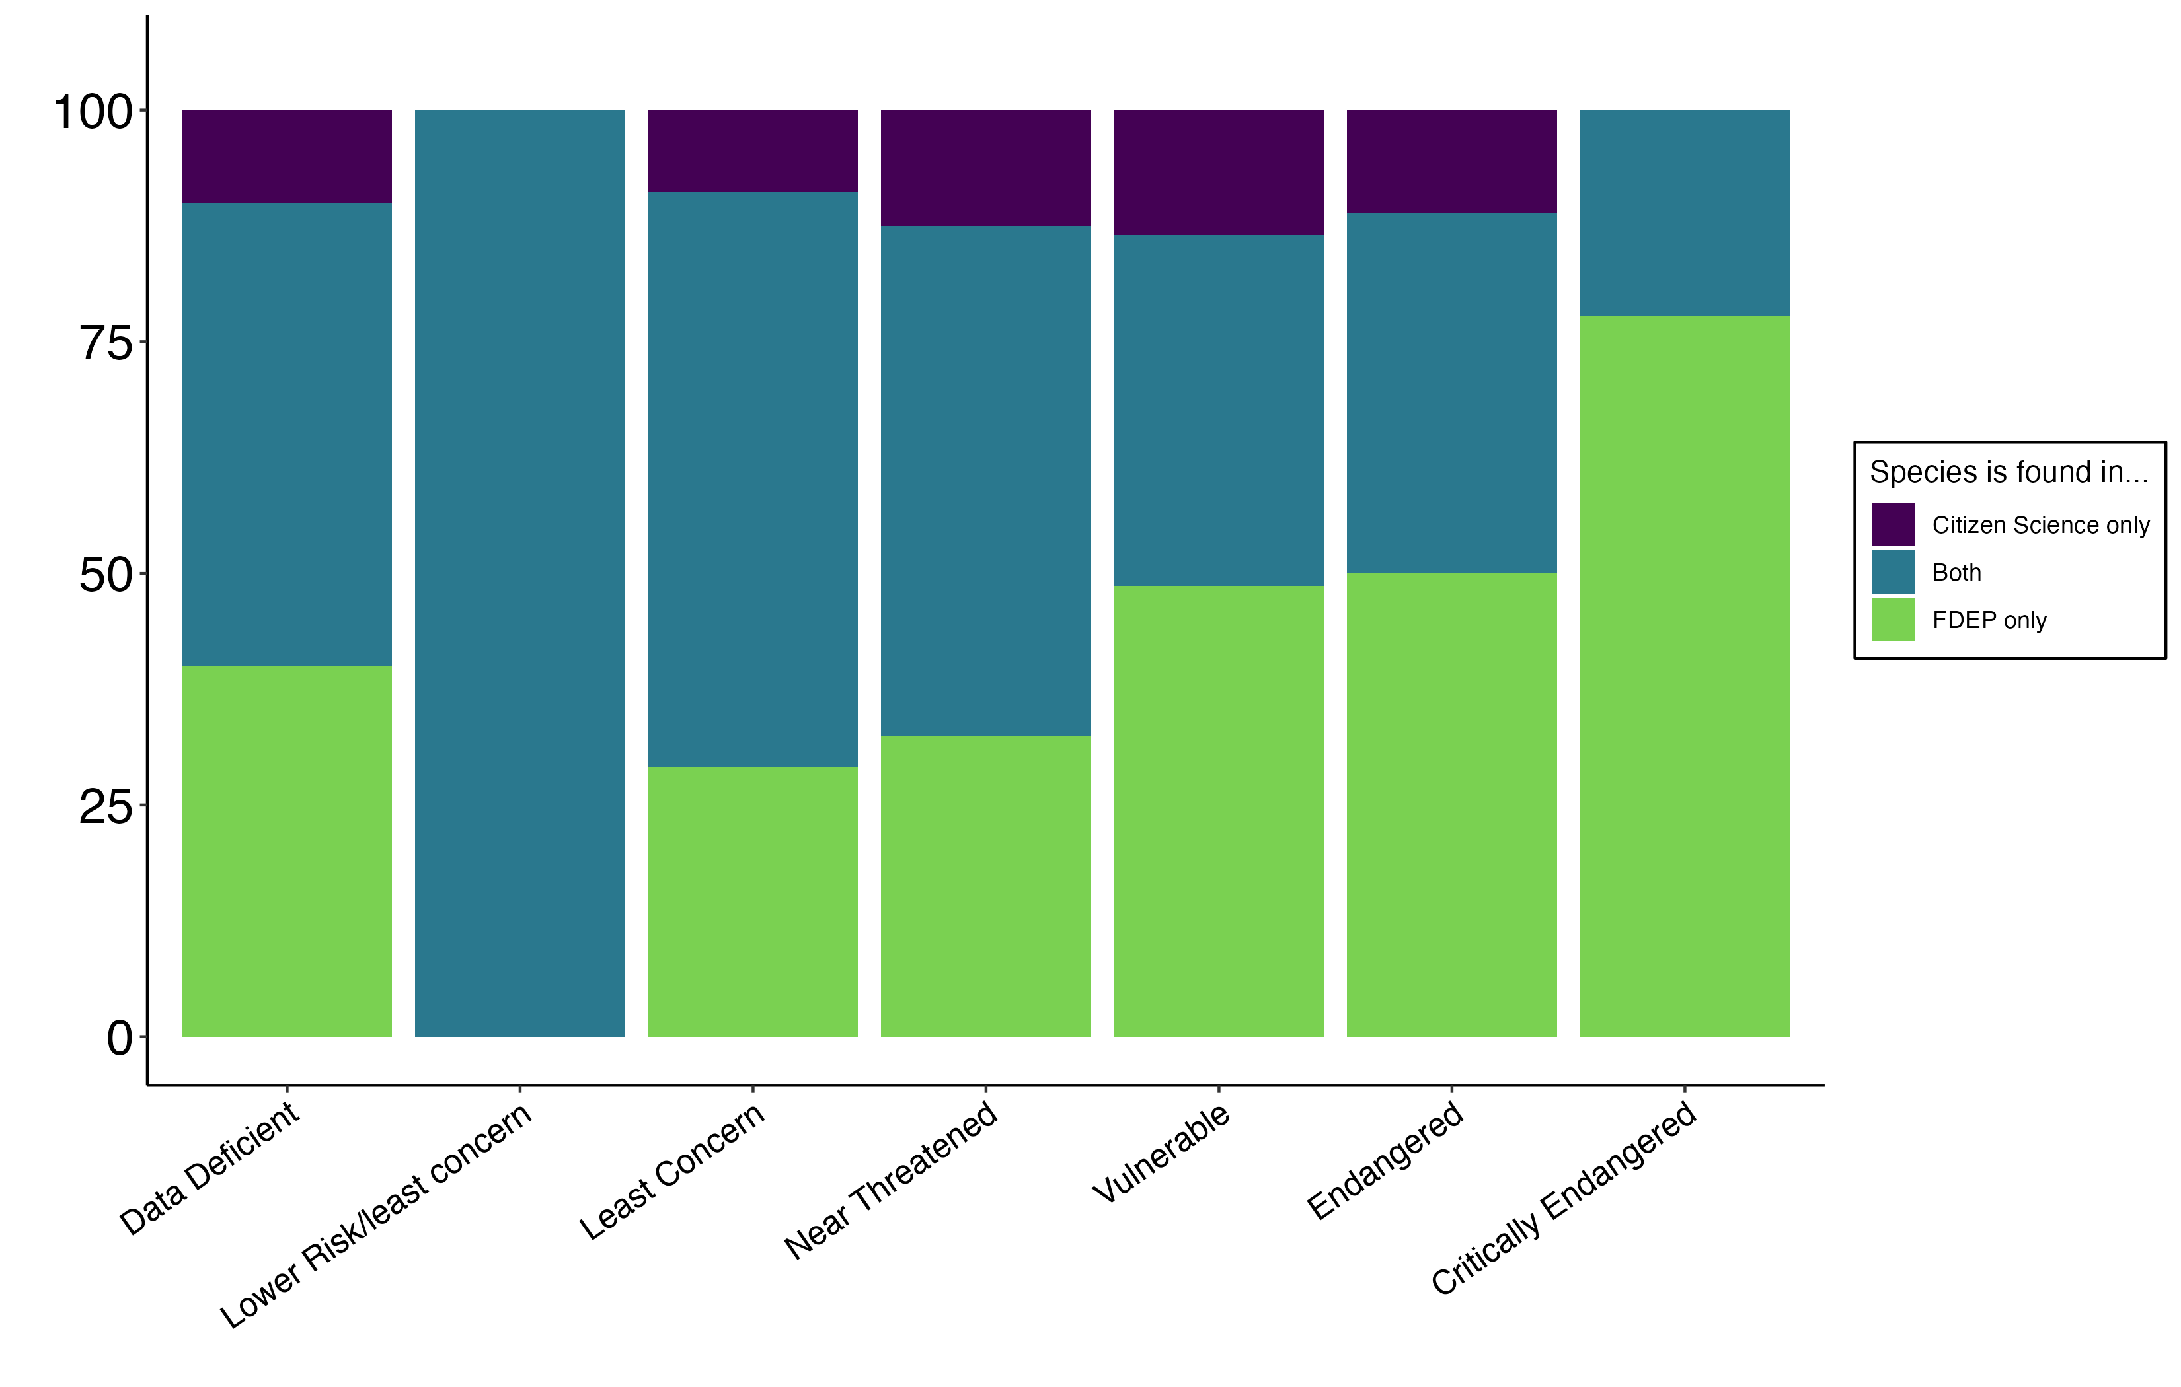

n = 10 n = 1 n = 1204 n = 40 n = 37 n = 18 n = 9
Total = 1,319 species
Percent of Species
IUCN Conservation Status
Notes:
Only about 25% of species have an IUCN conservation status

Slide 10
Effect of different park characteristics?
Variables tested:
Park acreage
Population of city where park is located
Park visitation in FY2022-23
Total unique citizen science observers
Total citizen science observations

Slide 11
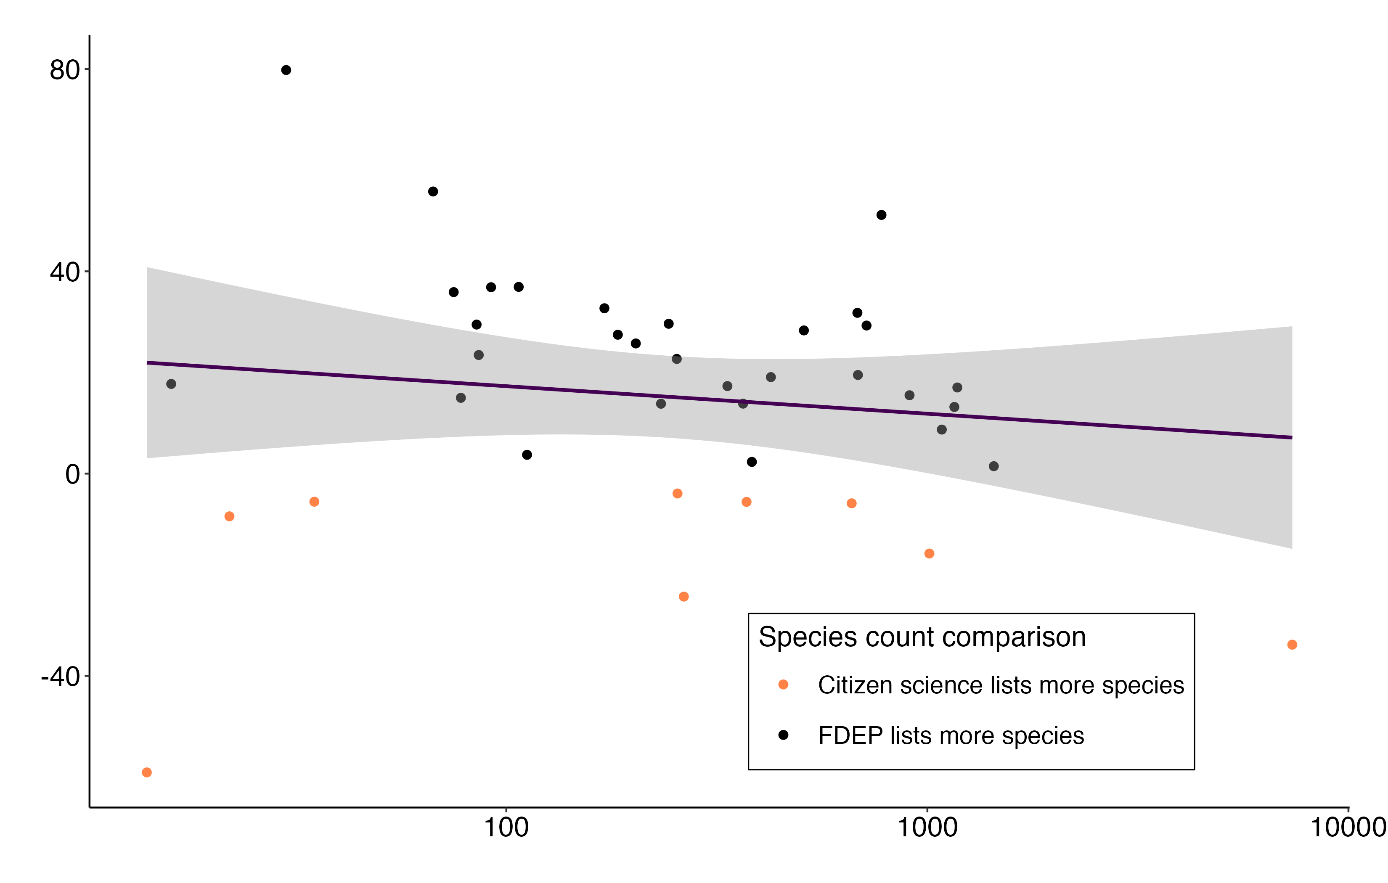
Percent difference in species counts
*Similar relationship with CS observations
Number of Unique Citizen Science Observers

Slide 12










Conclusions
Citizen science can fill gaps in state agency data in a cost-effective way
Citizen science consistently provides otherwise undocumented insects & birds and some species of conservation concern
Potential for more CS data and applications beyond Florida
Notes:
Insects, birds, species of conservation concern, CS data from eBird and iNat is increasing + ways to increase data with outreach, applications beyond Florida

Slide 13
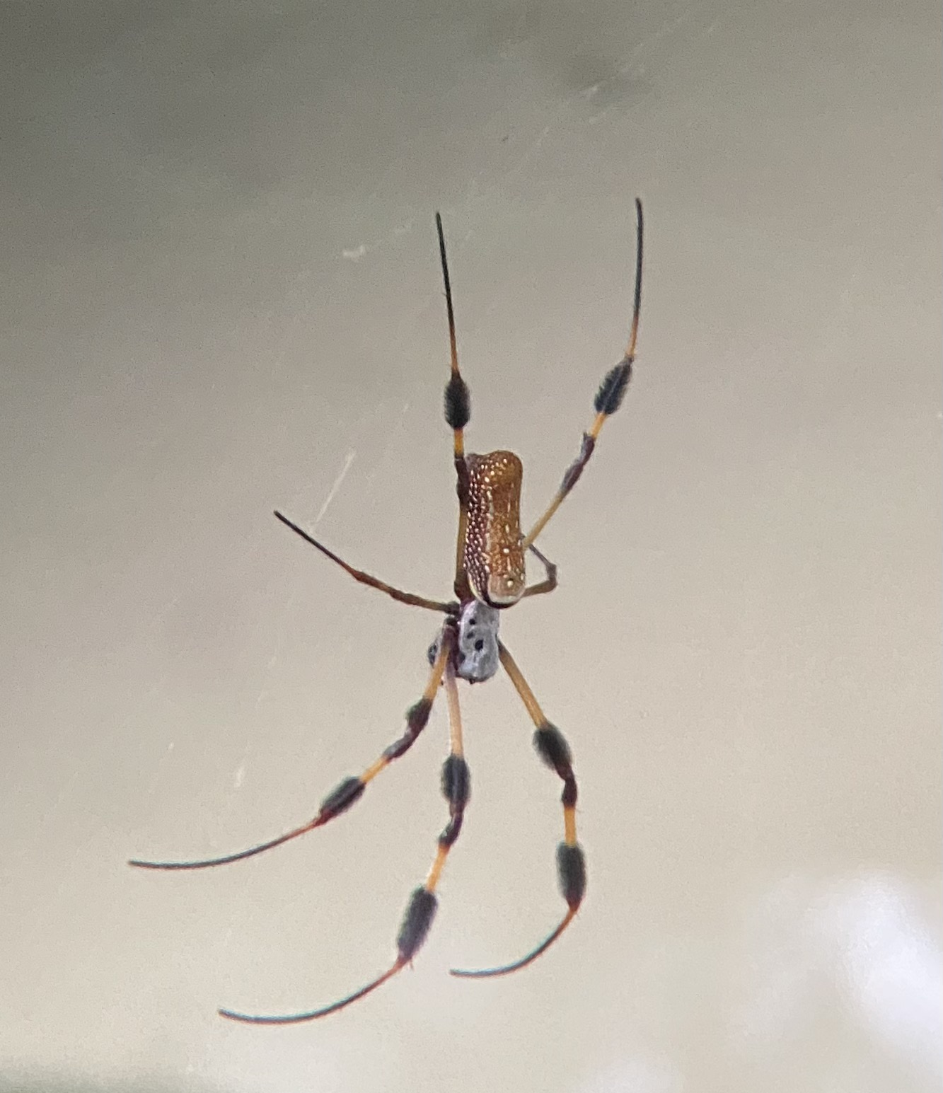
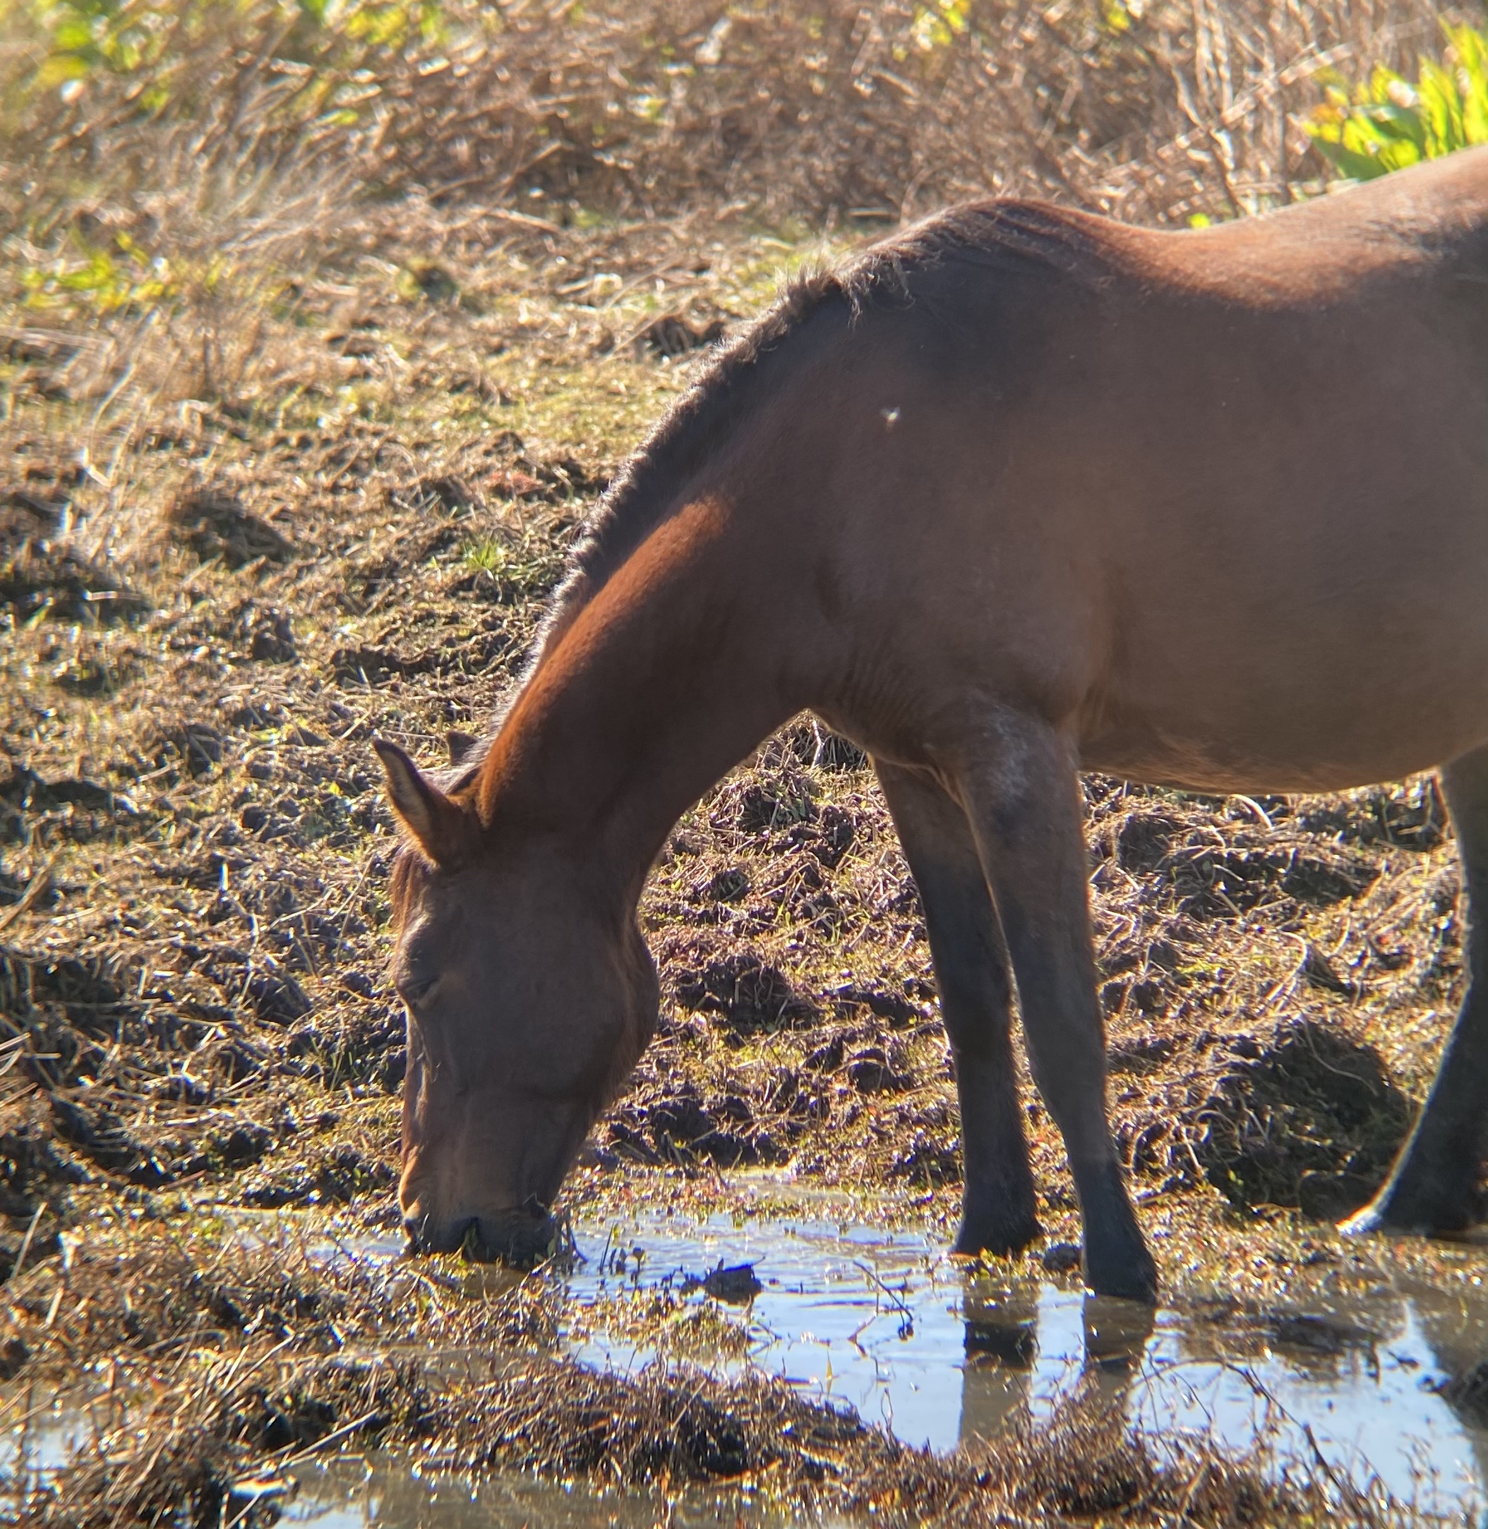
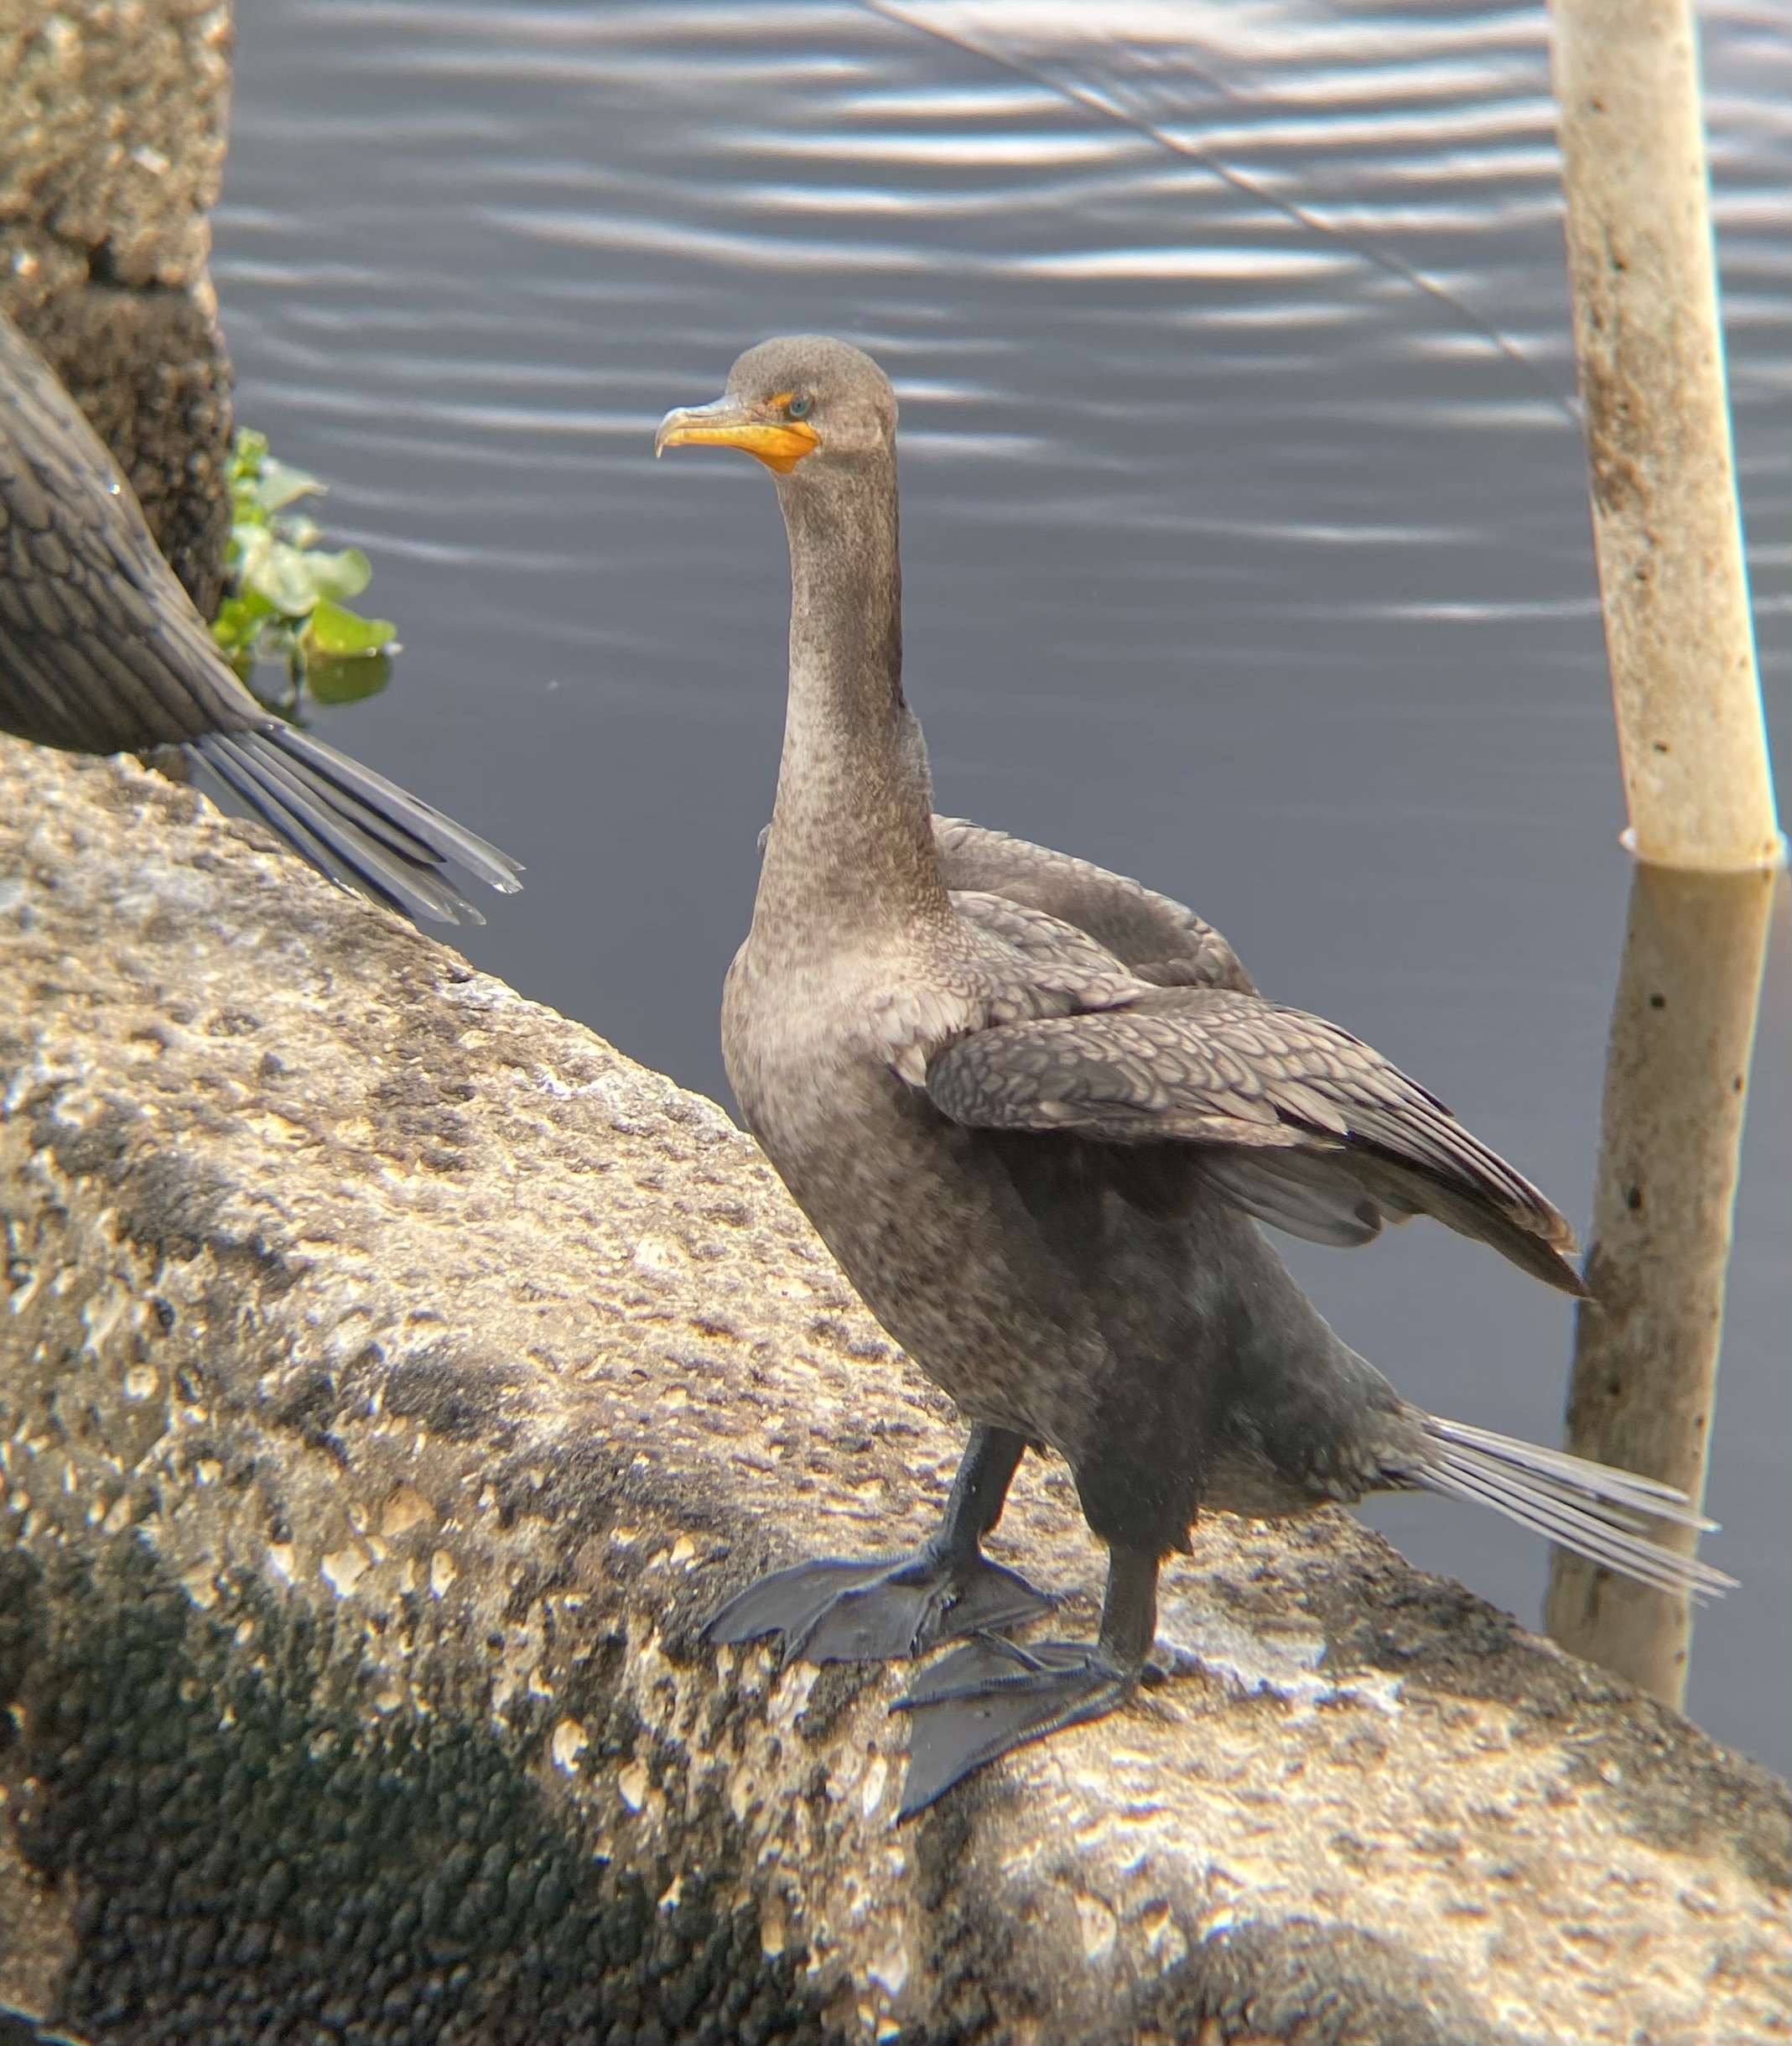
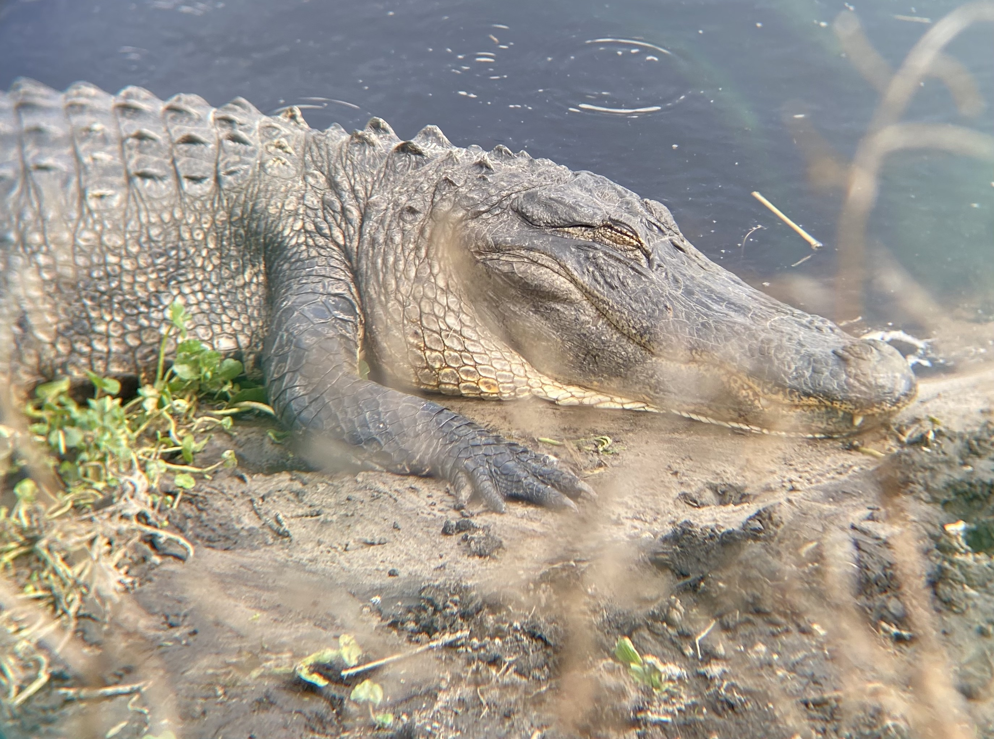
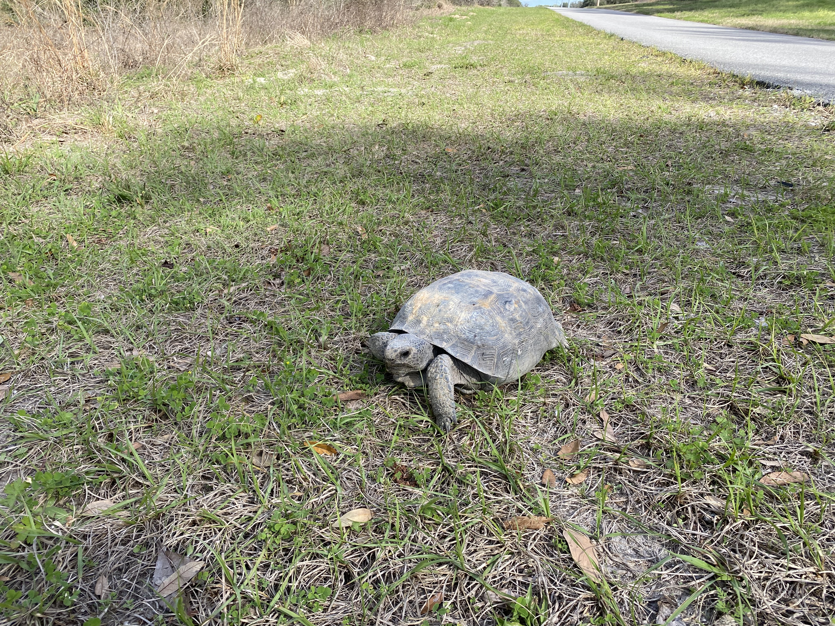
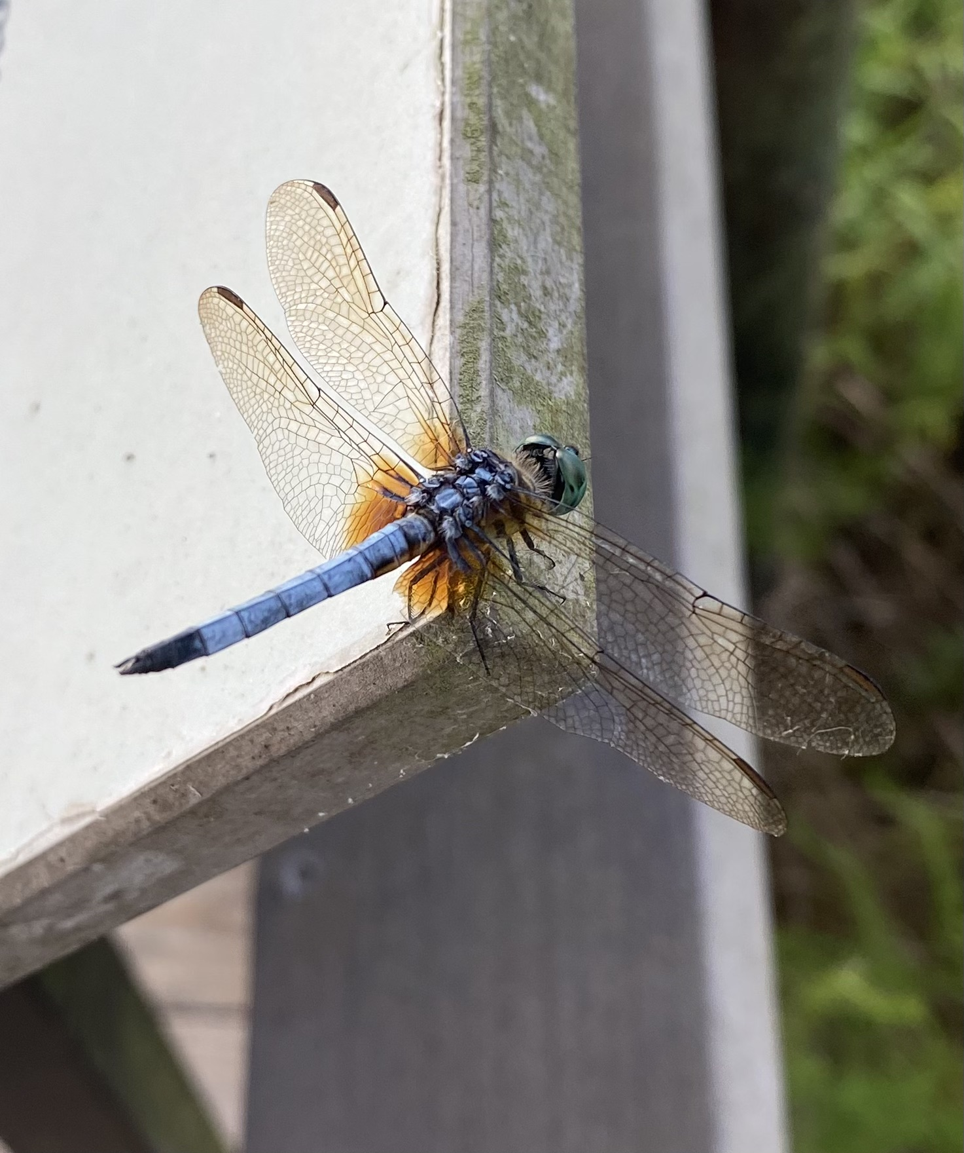
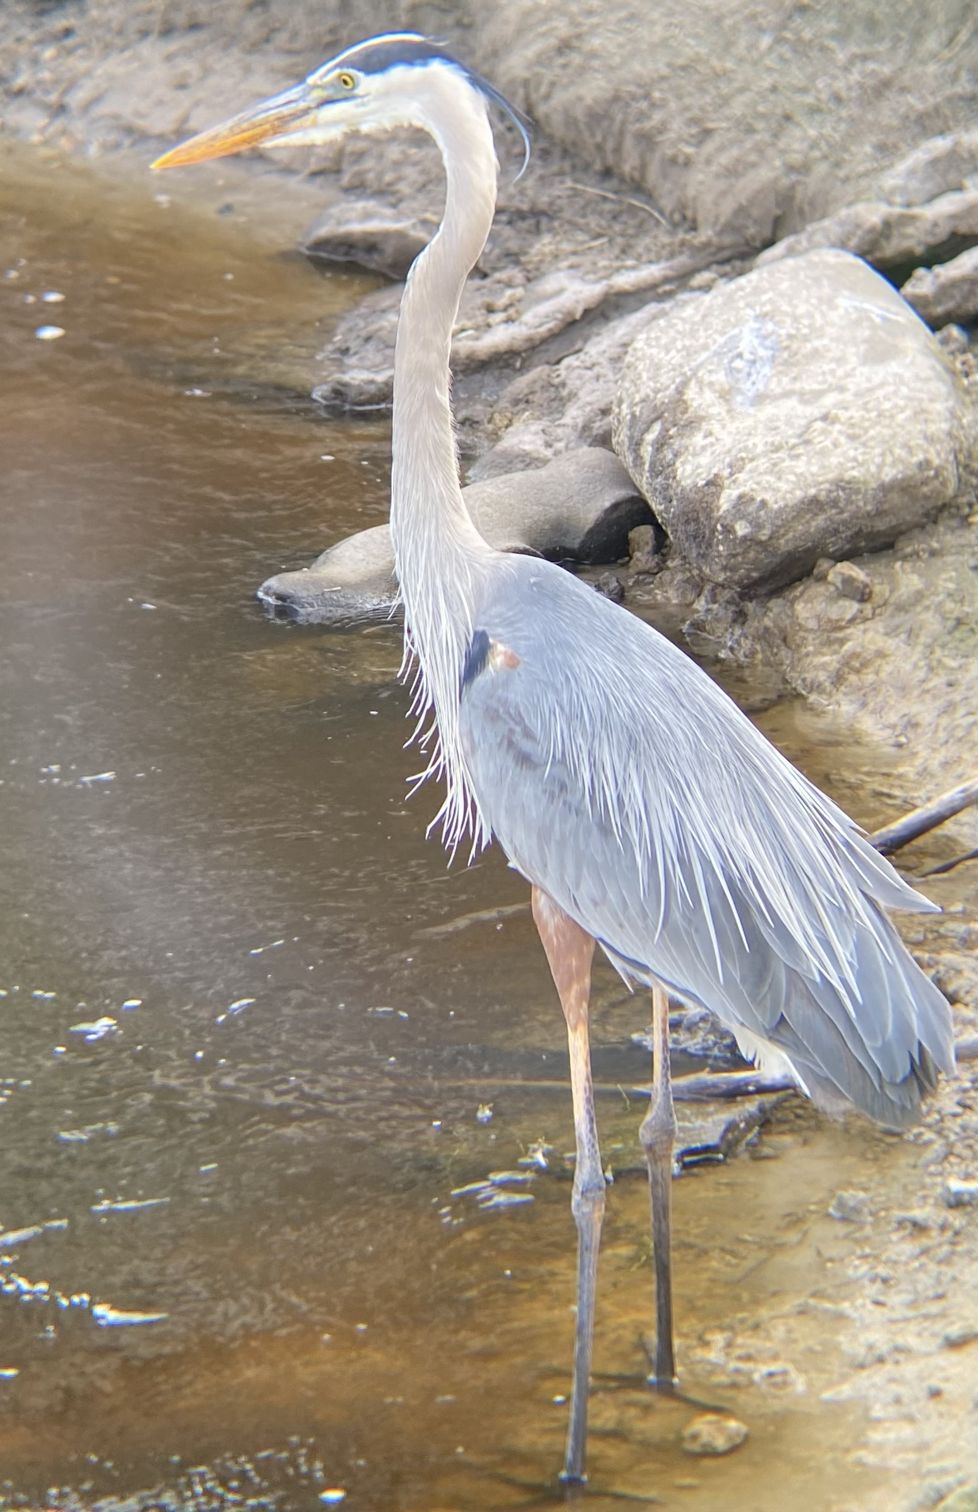
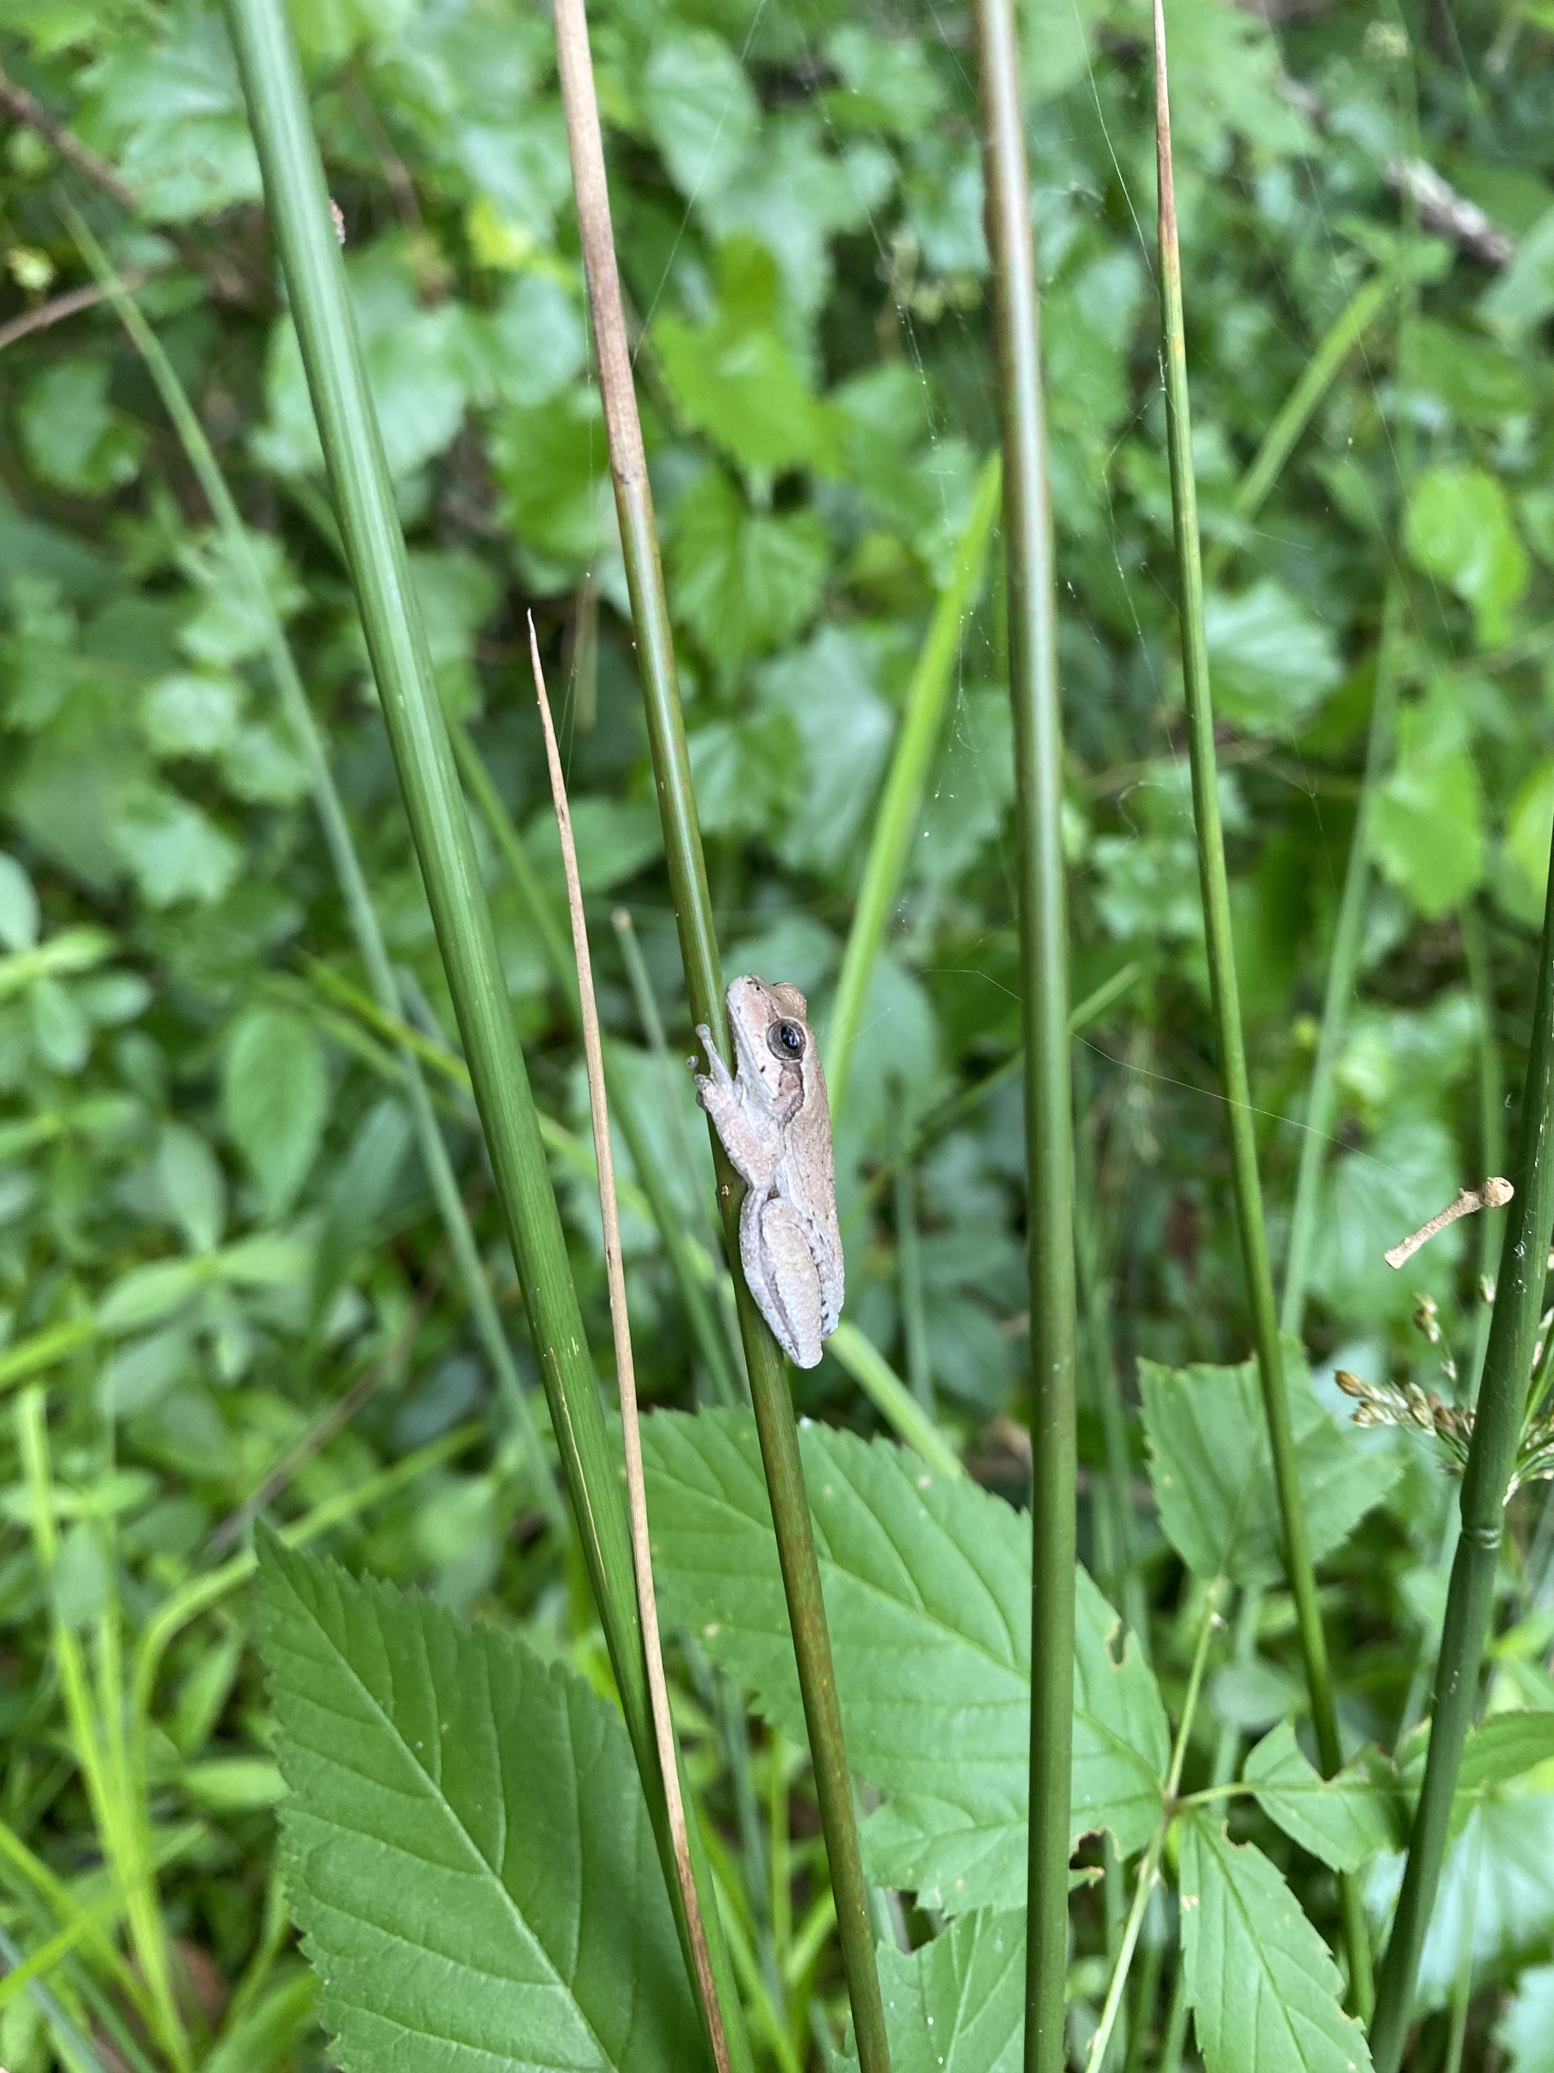
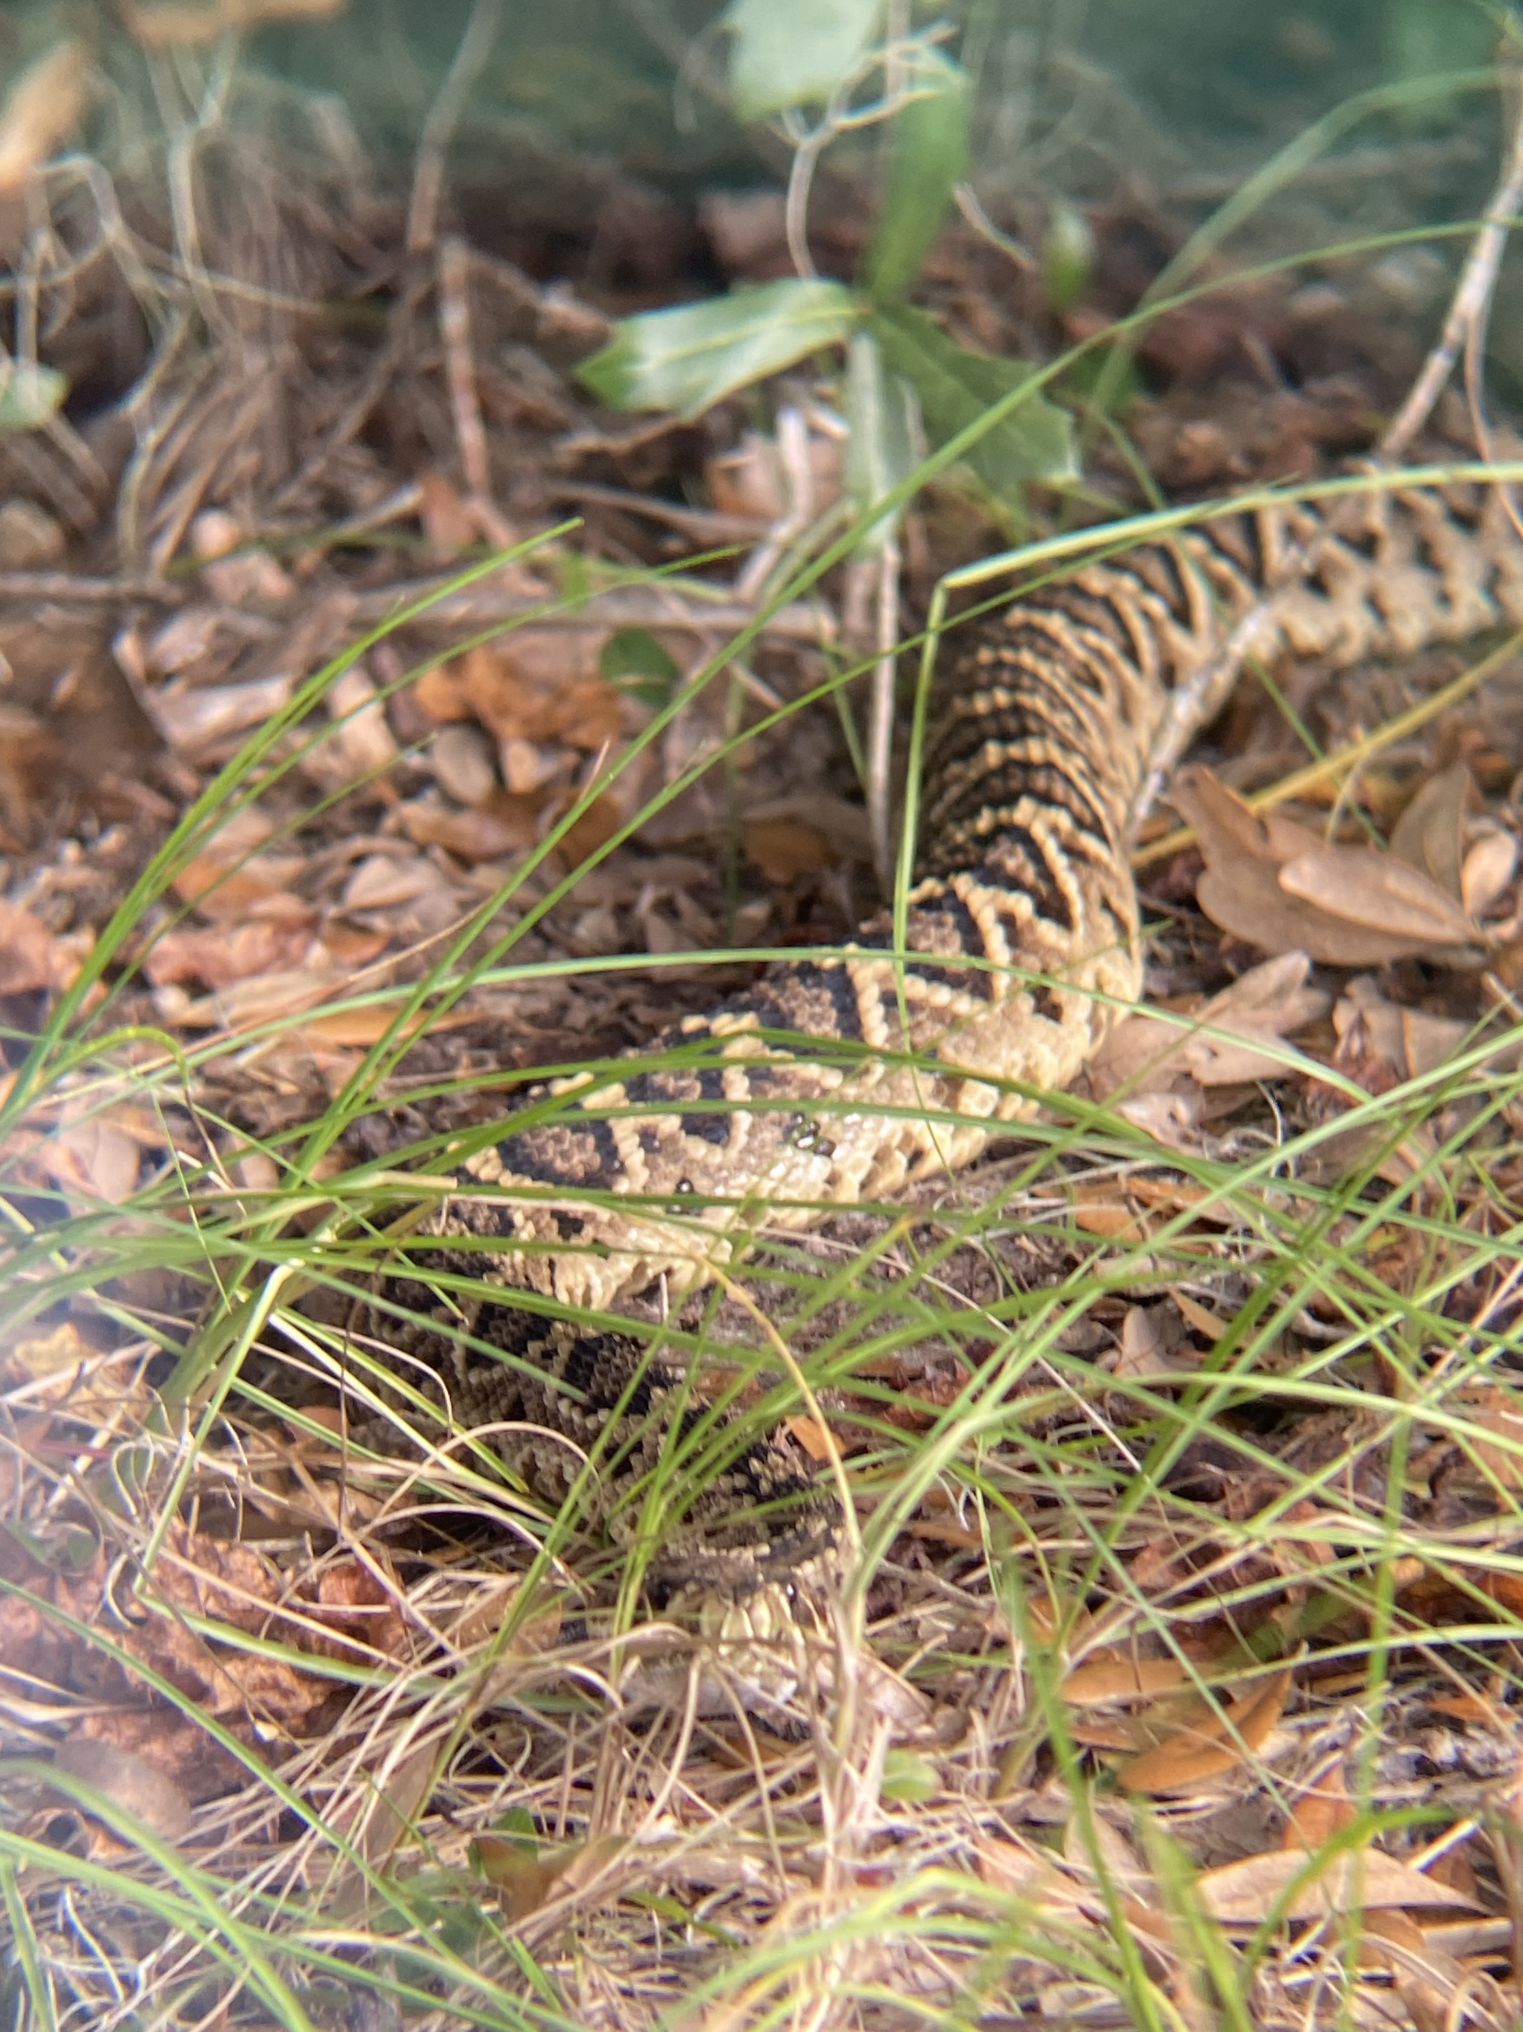
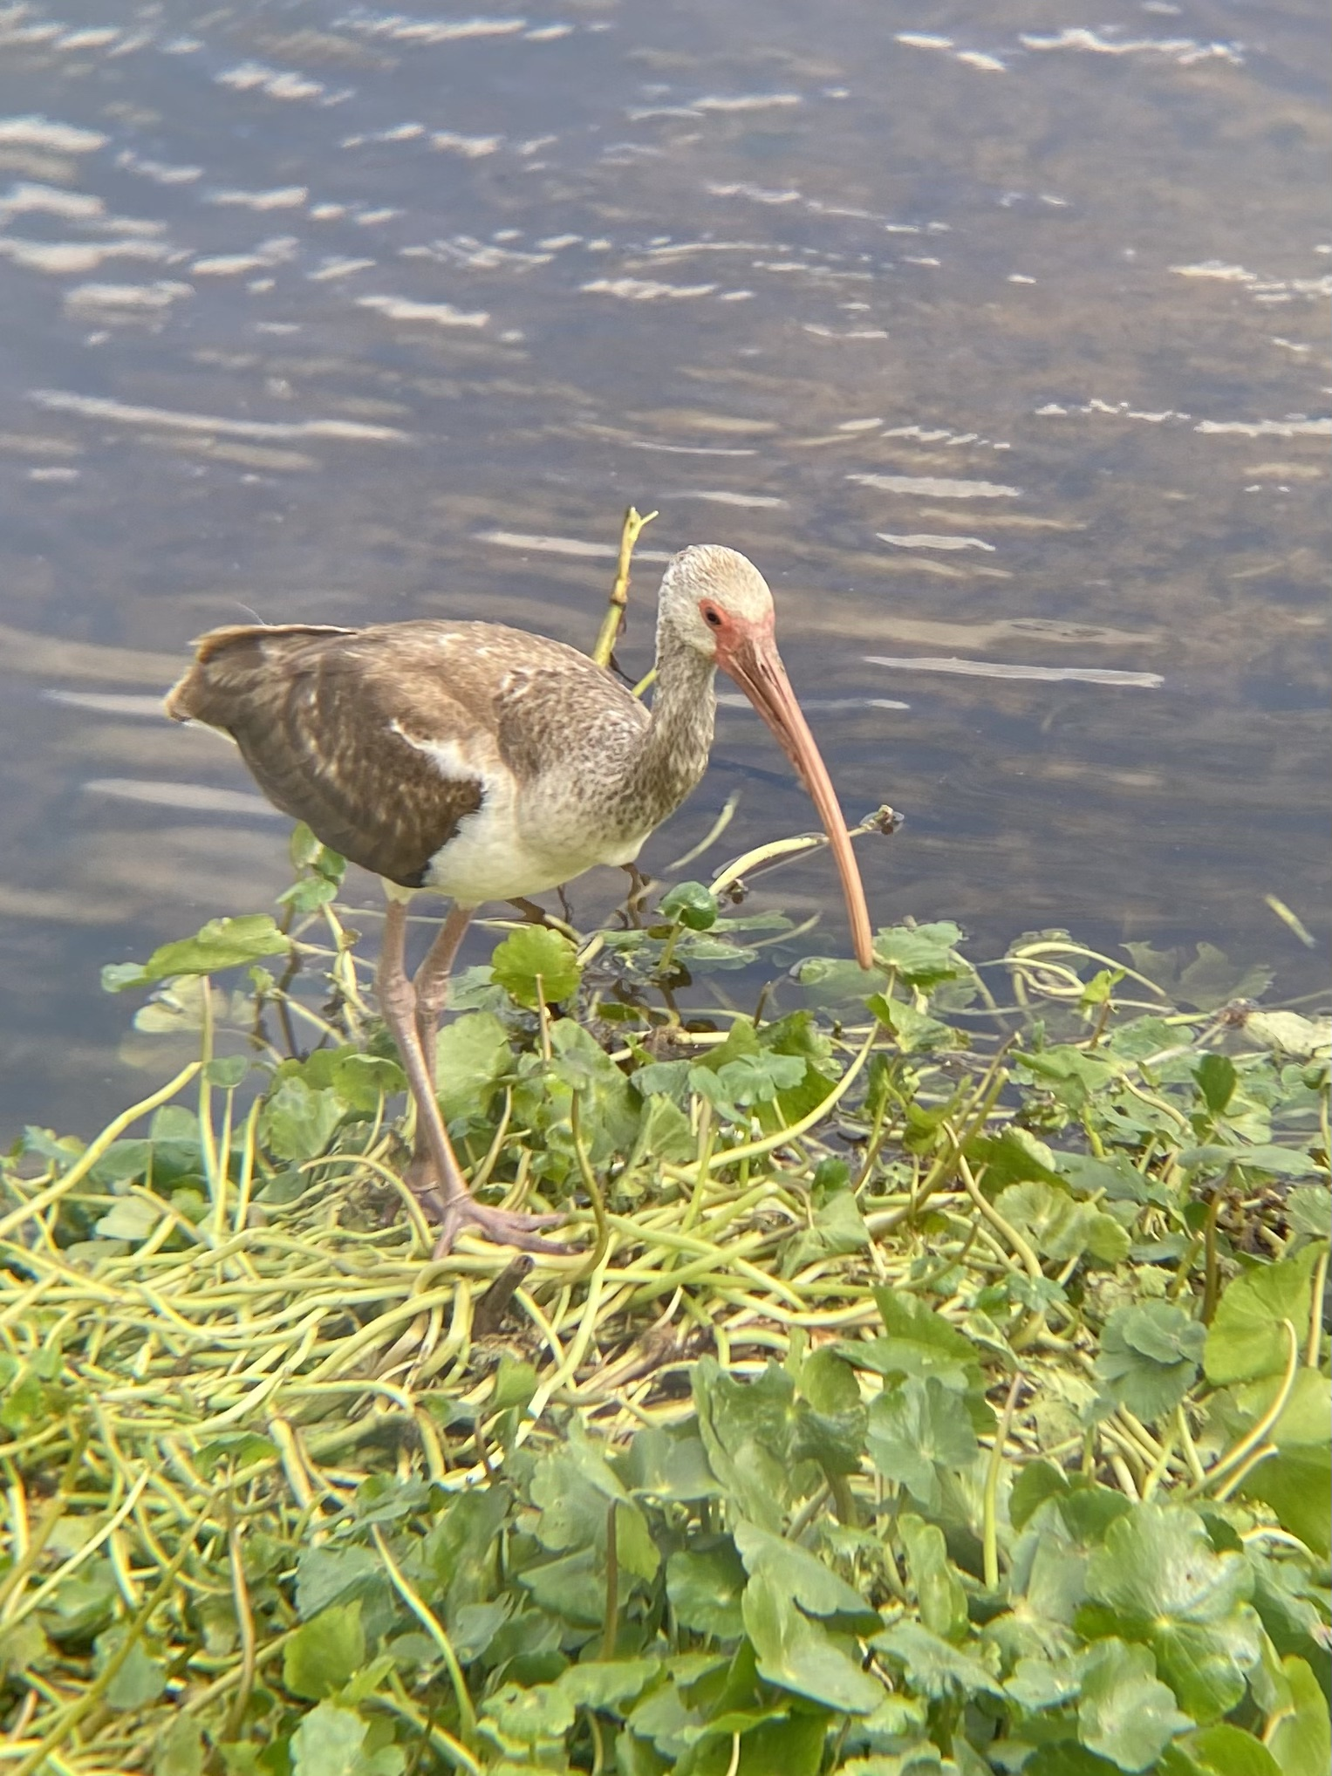
Thank you! Questions?
Notes:
Thank FDEP here if not done already
some of my fav pics from FL state parks

